Slide 1
Content Objective: Students will work on the project.
Wed - Thur January 29th - 30th
Work on Project - Per 1. Courtroom / Per 7. Ethical Dilemma / Per 8. A.I. Application
Homework
During projects only...

Slide 2

A.I. Application Project
Go here - https://x.company/
Explore the website and read about some of the ideas.
What is the purpose of this company?
Which idea did you like the most? Why?
Consider all of the problems that exist in the world, in your life, in your school, and in your community. Jot as many of these down as you can.
Consider all of the fun things humans do (the successes of humanity). The good parts of school, Boulder, Colorado, your hobbies and your home. Jot as many of these down as you can.
How can A.I. & Robotics solve the problems or improve the successes further? Begin brainstorming ideas...

Slide 3
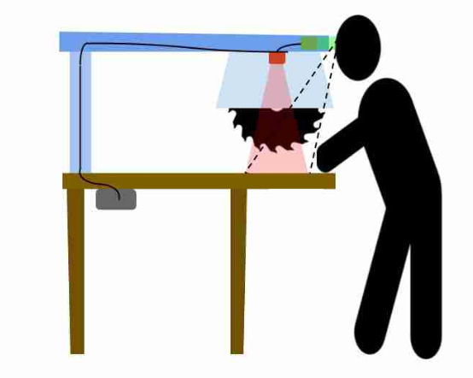
How could A.I. be used to make this situation safer?

Slide 4
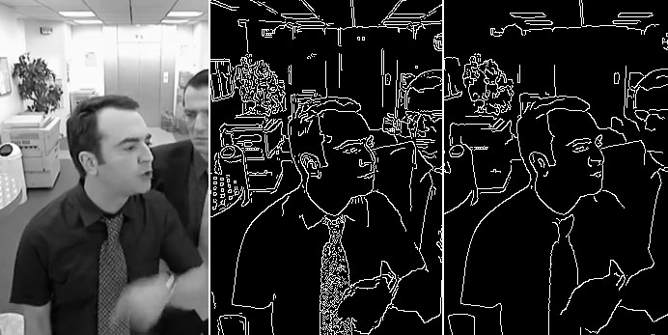
Edge Detection - Draw an example of an object that a computer would have a difficult time identifying…
What is edge detection and what problems could it create? Do you think we could create computers that can see like humans someday?

Slide 5
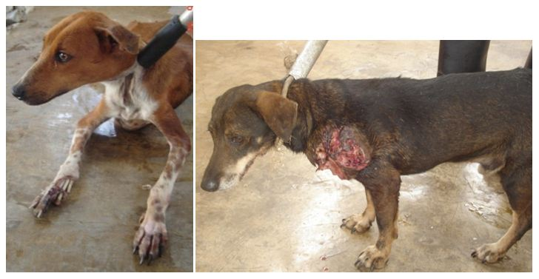
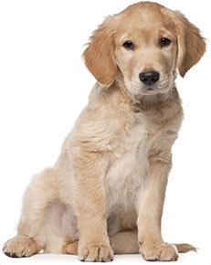
Data Representation - What is an example of something that the majority believes is right / good but that YOU disagree with…
What kind of decision does an A.I. jump to when it looks at data? How could this be a problem?
vs.

Slide 6
Scenario 1 - The Day the Yogurt Took Over
Scenario 2 - The Second Renaissance (9 min in)
Scenario 3 - Sophia Talks About Her Plan
Let’s look at three different societal scenarios...categorize these as being either “evil,” “neutral,” or “good.” Come up with reasons why you feel these outcomes are good or bad and be ready to defend your thinking. Jot down significant moments that seem to go against (or with) your own ethical code.

Slide 7
A.I. Ethical Dilemma
Menu of Choices: Select one and begin researching! Remember you will be teaching your topic to your classmates...consider what teachers do to excite, and engage others to learn. Uygur Muslim Humanitarian Crisis in China / Facial Recognition Autonomous Weapons Autonomous Cars China’s “Social Credit” System (Coming to America?) Deep Fakes / New Age Propaganda A.I. Relationships (friendship, relationship, companionship, assistant) A.I. Racial Bias in Court Decisions A.I. Replacing Jobs / Universal Basic Income Using A.I. Drones on the Border Instead of Building Wall A.I. Teaching and Online Learning Other?

Slide 8
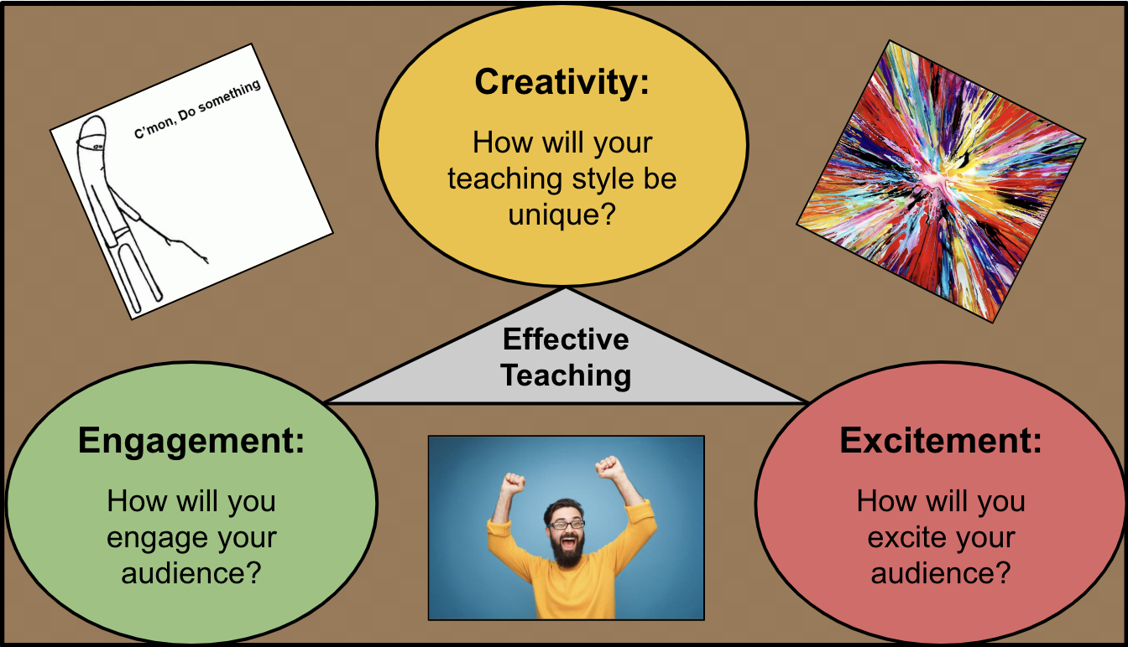
How can you turn your boring presentation into a teaching moment?

Slide 9
Menu of Choices: Select one and begin learning the situation or creating it… Real Cases: Death of Elaine Herzberg - Self Driving Car Crash Case Apple v. FBI - FBI Cracking Smartphones for Evidence - Dec 2015 San Bernardino Mass Shooting Naruto v Slater - A Monkey and It’s Money Making Selfie Dredd Scott Case - A Slave Fights for His Freedom Hypothetical Future Cases: B1-668 v. Humanity Trial - Robot Servant Kills Master who Threatened to Turn It Off / Replace It Truckers Union v. UPS / TuSimple - Truck Drivers Fight for Their Jobs Family of Elderly Person v. Emotional Support Robot Company - Woman Asks Robot to Kill Her in State Where Assisted Suicide is Ilegal Amputee v. Prosthetic - Prosthetic Arm Malfunctions and Crushes Hands

